Slide 1
Feasibility of launching the new online video service
Shirin Younesian
March 2023

Slide 2
Project Context These days, Rockbuster Stealth as a movie rental company that has stores around the world is facing stiff competition from streaming services such as Netflix and Amazon Prime, this project investigates the effective factors in launching online video rental services in order to stay competitive.
Which movies contributed the most/least to revenue gain?
What was the average rental duration for all videos?
Which countries are Rockbuster customers based in?
Where are customers with a high lifetime value based?
Do sales figures vary between geographic regions?
Key Questions

Slide 3
Initial Data
Number of Movies 1000
Number of Customers 599
Total Revenue 61312.04 $
Number of Countries 108
Statistical information is extracted based on all the data available in the company's current production database

Slide 4
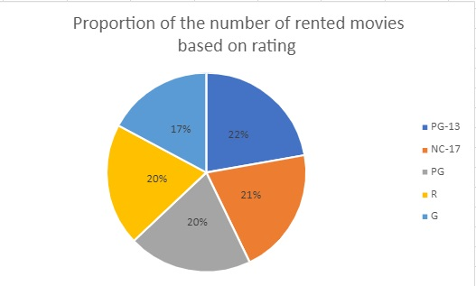
Movie Data Analysis
Average Rental Duration is 5 days
Average rental Rate is 3$ per day
Movies with PG_13 rating, have the highest rental share and movies with G rating, have the lowest rental share
Rental Duration (day)
MAX 7
AVG 5
MIN 3
Rental Rate ($/day)
MAX 5
AVG 3
MIN 1
Replacment Cost ($)
MAX 30
AVG 20
MIN 10

Slide 5
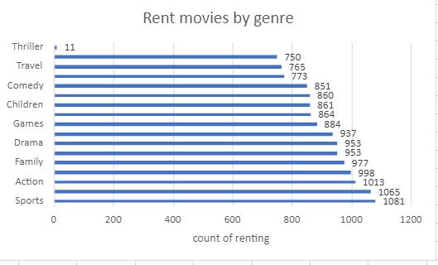
Movie Data Analysis
The Sport genre with the highest number of movie rentals is the most popular and the Thriller genre is the least popular and demanded
The most popular movies based on the rental amount
Movie with the highest rent
Telegraph Voyage
215.75 $
Movies with the lowest rent
Texas Watch
Oklahoma Jumanji
Duffel Apocalypse
5.94 $

Slide 6
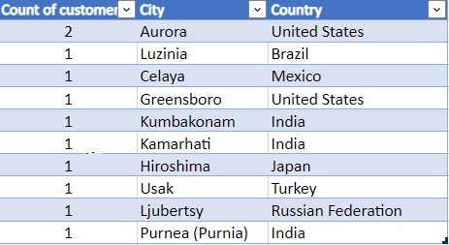
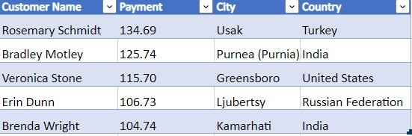
Customer and Country Data Analysis
Top 10 cities within the top 10 countries based on payment
Top 5 customers in the top 5 cities based on payment
These cities are where there are customers with a high lifetime value

Slide 7
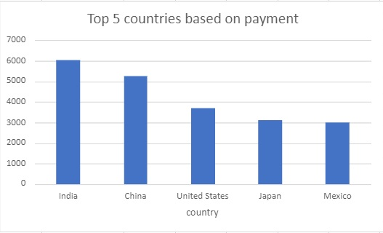
Customer and Country Data Analysis
Top 5 countries based on payment

Slide 8
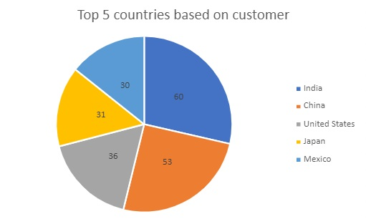
Customer and Country Data Analysis
The active customers of the company are located in 108 countries
The total number of customers is 599
India has the largest number of customers with 60 active customers
41 countries such as Finland and Nepal have the lowest number of active customers with only one customer
Top 5 countries based on number of customer

Slide 9
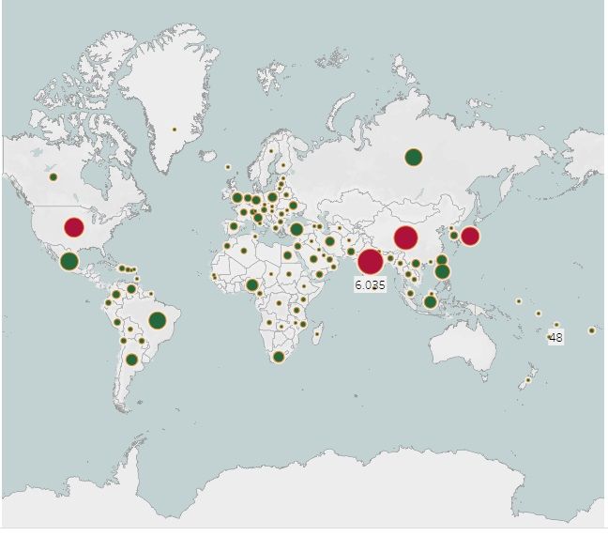
Geographical distribution of customers and the revenue
Based on the two factors of customer and revenue, the top countries among 108 countries are:
India
China
Japan
United States
American Samoa with 1 customer and 48$ payment is the lowest income region
Link to Public Tableau

Slide 10
Conclusion and Recommendation
Data analysis shows that movies with PG_13 rating, have the highest rental share and have the most demand for renting, and movies with G rating, have the lowest rental share.
The most popular genres are Sport, Animation, and Action, which have the highest movie rental rates and the lowest demand is for the genre Thriller.
India and China have the highest rank in the number of customers and revenue
From a regional point of view, Asia has the highest amount of revenue and the number of customers, followed by America
The average rental rate across all active countries is 3$

Slide 11
Conclusion and Recommendation
The following points are recommended for developing an effective strategy for online movie services:
The Asian region, especially the three countries of India, China and Japan, can be the target market for providing online services, followed by North America
Considering the popularity of Sports, Animation, and Action genres, it is better to increase the number and variety of these movies
Attention to the cultural and taste differences and the language of customers (in all age groups)in each country
Attention to the limitations in technology and communication infrastructure in each country
Feasibility of local payment solutions and, Income level of customers in different countries
Knowledge of laws governing countries

Slide 12
THANK YOU
Shirin Younesian
sh.younesian@gmail.com

